Slide 1
June 24, 2023

Slide 2
Introduction to Applied Data Science in Python
QBS 195
Simon Stone✤, Jeremy Mikecz ✤, Carly Bobak✦
✤Research Data Services, ✦Research Computing
Dartmouth College

Slide 3
About Research Data Services
Research Data Management
Data Management Plans (DMPs) for sponsored projects
Finding and using 3rd party data
Collection and cleaning of data
Organization and documentation
Publishing and Repositories
Data Analysis/Visualization
Textual, numeric, spatial data
Reproducible research workflows
Scripting in R: tidyverse core package (i.e. ggplot, dplyr, tydr, tibble, etc.)
Scripting in Python: NumPy, SciPy, Pandas, Scikit-learn, Matplotlib, Seaborn, (OpenCV, PyTorch, TensorFlow, Tesseract, NLTK, etc.)
Computational Scholarship
Computational project planning
Collections as Data
Storytelling with data and visualizations
Text and data mining
Digital Humanities support
Computational Pedagogy

Slide 4
About Research Computing

Slide 5
Work with us
ResearchDataHelp@groups.dartmouth.edu
[RC contact info]
Jeremy Mikecz Research Data Science Specialist jeremy.m.mikecz@dartmouth.edu dartgo.org/jeremyappts | Simon Stone Research Data Science Specialist simon.stone@dartmouth.edu dartgo.org/meetwithsimon
Lora Leligdon Head of Research Data Services lora.c.leligdon@dartmouth.edu dartgo.org/lora

Slide 6



Introduction Data Science
Data science is the study of data to extract meaningful insights for business.
Challenge:
Define Data Science!
https://aws.amazon.com/what-is/data-science/
Data science […] uncover[s] actionable insights hidden in an organization’s data.
https://www.ibm.com/topics/data-science
[Data science] models and analyzes key data to continually improve how businesses utilize data.
https://cloud.google.com/learn/training/machinelearning-ai

Slide 7
Introduction Data Science
Data Engineer
Data Analyst
Machine Learning Engineer
Collect
Clean
Clean
Build and assess model
Exploratory Data Analysis
Model implementation
Deployment
Data Scientist
Data Science is OSEMN!*
Obtain
Scrub
Explore
Model
iNterpret
*pronounced “awesome” - /ˈɔ.səm/ https://www.datascience-pm.com/osemn

Slide 8

Outline
Introduction
Schedule
Learning Objectives
What makes a Data Science project special?
What makes a Python project special?
Tools of the Trade
Summary
Assignment
Munroe, R. (n.d.). Data Pipeline. xkcd. https://xkcd.com/2054/ (CC BY-NC 2.5)

Slide 9
Learning Objectives
Complete a data science project through the process of finding, cleaning, compiling, exploring, analyzing, visualizing, and modeling data.
Become proficient at writing and applying Python code to complete these data science steps.
Practice effectively communicating (and providing critical feedback on) data science research.
Apply the principles of reproducible research throughout the data science lifecycle.

Slide 10
Format
Class times:
Monday, 4 pm – 5:30 pm
Wednesday, 4 pm – 5:30 pm
Classes will consist of lectures, code-alongs, hands-on project work, or a mix of all the above
There will be assignments to continue the engagement with each week’s content
At the end of each Wednesday class, there is time for project check-ins, show & tell, or troubleshooting
Each student is expected to hand in a final project

Slide 11
Format Final Project
Project requirements:
Devise a business or research question that can be answered through data
Identify a suitable dataset
Implement all major steps of a data science project to find an answer to the chosen question
Deliverables:
Project pitch (details to come)
Fully reproducible project repository
Final presentation

Slide 12
Schedule
Week 1 (June 26 & June 28):
Getting Started with Applied Data Science & Python
Introduction to Applied Data Science with Python
Data Wrangling
Week 2 (July 3 & July 5):
Texts, Maps, and Graphs
Data Visualization
NLP I
Week 3 (July 10 & July 12):
Texts as Data
NLP II
NLP III
Week 4 (July 17 & July 19):
Machine Learning
Scikit-learn
PyTorch
Week 5 (July 24 & July 26):
Project Work
Project proposals due(Monday July 24)
No class meetings
Week 6 (July 31 & August 2):
No class meetings
Week 7 (August 7 & August 9):
Collaboration and Documentation
Documenting, Sharing and Evaluating Code
Peer Review
Week 8 (August 14 & August 16):
Code Revision Work
No Class Meetings
Week 9 (August 21 & August 23):
Final Presentations and revised code due (Wed. Aug 23)

Slide 13
Policy on Generative AI
Use of generative AI is generally accepted in this course if it meets the following requirements:
You are expected to take full ownership of your work, including the use of generative AI
You need to be able to understand and reflect any output of generative AI you want to include in your work
“It’s a tool, you’re its master!”
Just like with code taken from other sources (e.g., Stack Overflow), any code other than your own must be cited (see Week 7: Documentation)
You are expected to be able to explain and discuss every line of code in your final project

Slide 14
Applied Data Science with Python What makes a Data Science project special
Typical project has two phases:
Exploration phase
Explore data, imputations, feature engineering, model selection
Reporting and “deployment” phase
Generate result tables and graphs, refactor code, export trained models
Subject matter domains differ, tasks are similar
Multiple stakeholders to consider, “interrogate”, and convince

Slide 15
Applied Data Science with Python What makes a Python project special
Powerful language with incredible community and industry support
Often large number of (inter-)dependencies
Rapid prototyping
(Mostly) cross-platform compatible on Windows, Mac OS, Linux
Sprawling, sometimes confusing ecosystem
Deployment / reproducibility can be challenging

Slide 16
Applied Data Science with Python Tools of the Trade
Integrated Development Environment (IDE) for writing code
Command line scripts for project setup and configuration
Jupyter notebooks for prototyping and reporting
Version control for code (and sometimes data)
Not part of this course:
Cloud infrastructure (Amazon Web Services, Google Cloud, Microsoft Azure)

Slide 17
Tools of the Trade Anti-patterns
“A commonly-used process, structure or pattern of action that, despite initially appearing to be an appropriate and effective response to a problem, has more bad consequences than good ones.”
Gang of Four*
Not using an IDE
Not organizing your project in one place
Using a too simple or too elaborate project setup
Overusing Jupyter notebooks (sometimes scripts are better)
Not managing your Python environment
* Gamma, E., Helm, R., Johnson, R., Vlissides, J. (1995). Design patterns: elements of reusable object-oriented software. Boston, MA, USA: Addison-Wesley Longman Publishing Co., Inc.. ISBN: 0-201-63361-2

Slide 18

Tools of the Trade Recommended Setup for this class
Recommended Python distribution:
Vanilla Python 3.8 or newer: https://www.python.org/
Recommended IDE:
Visual Studio Code: https://code.visualstudio.com/
Recommended version control hosting platform
GitHub: https://www.github.com

Slide 19
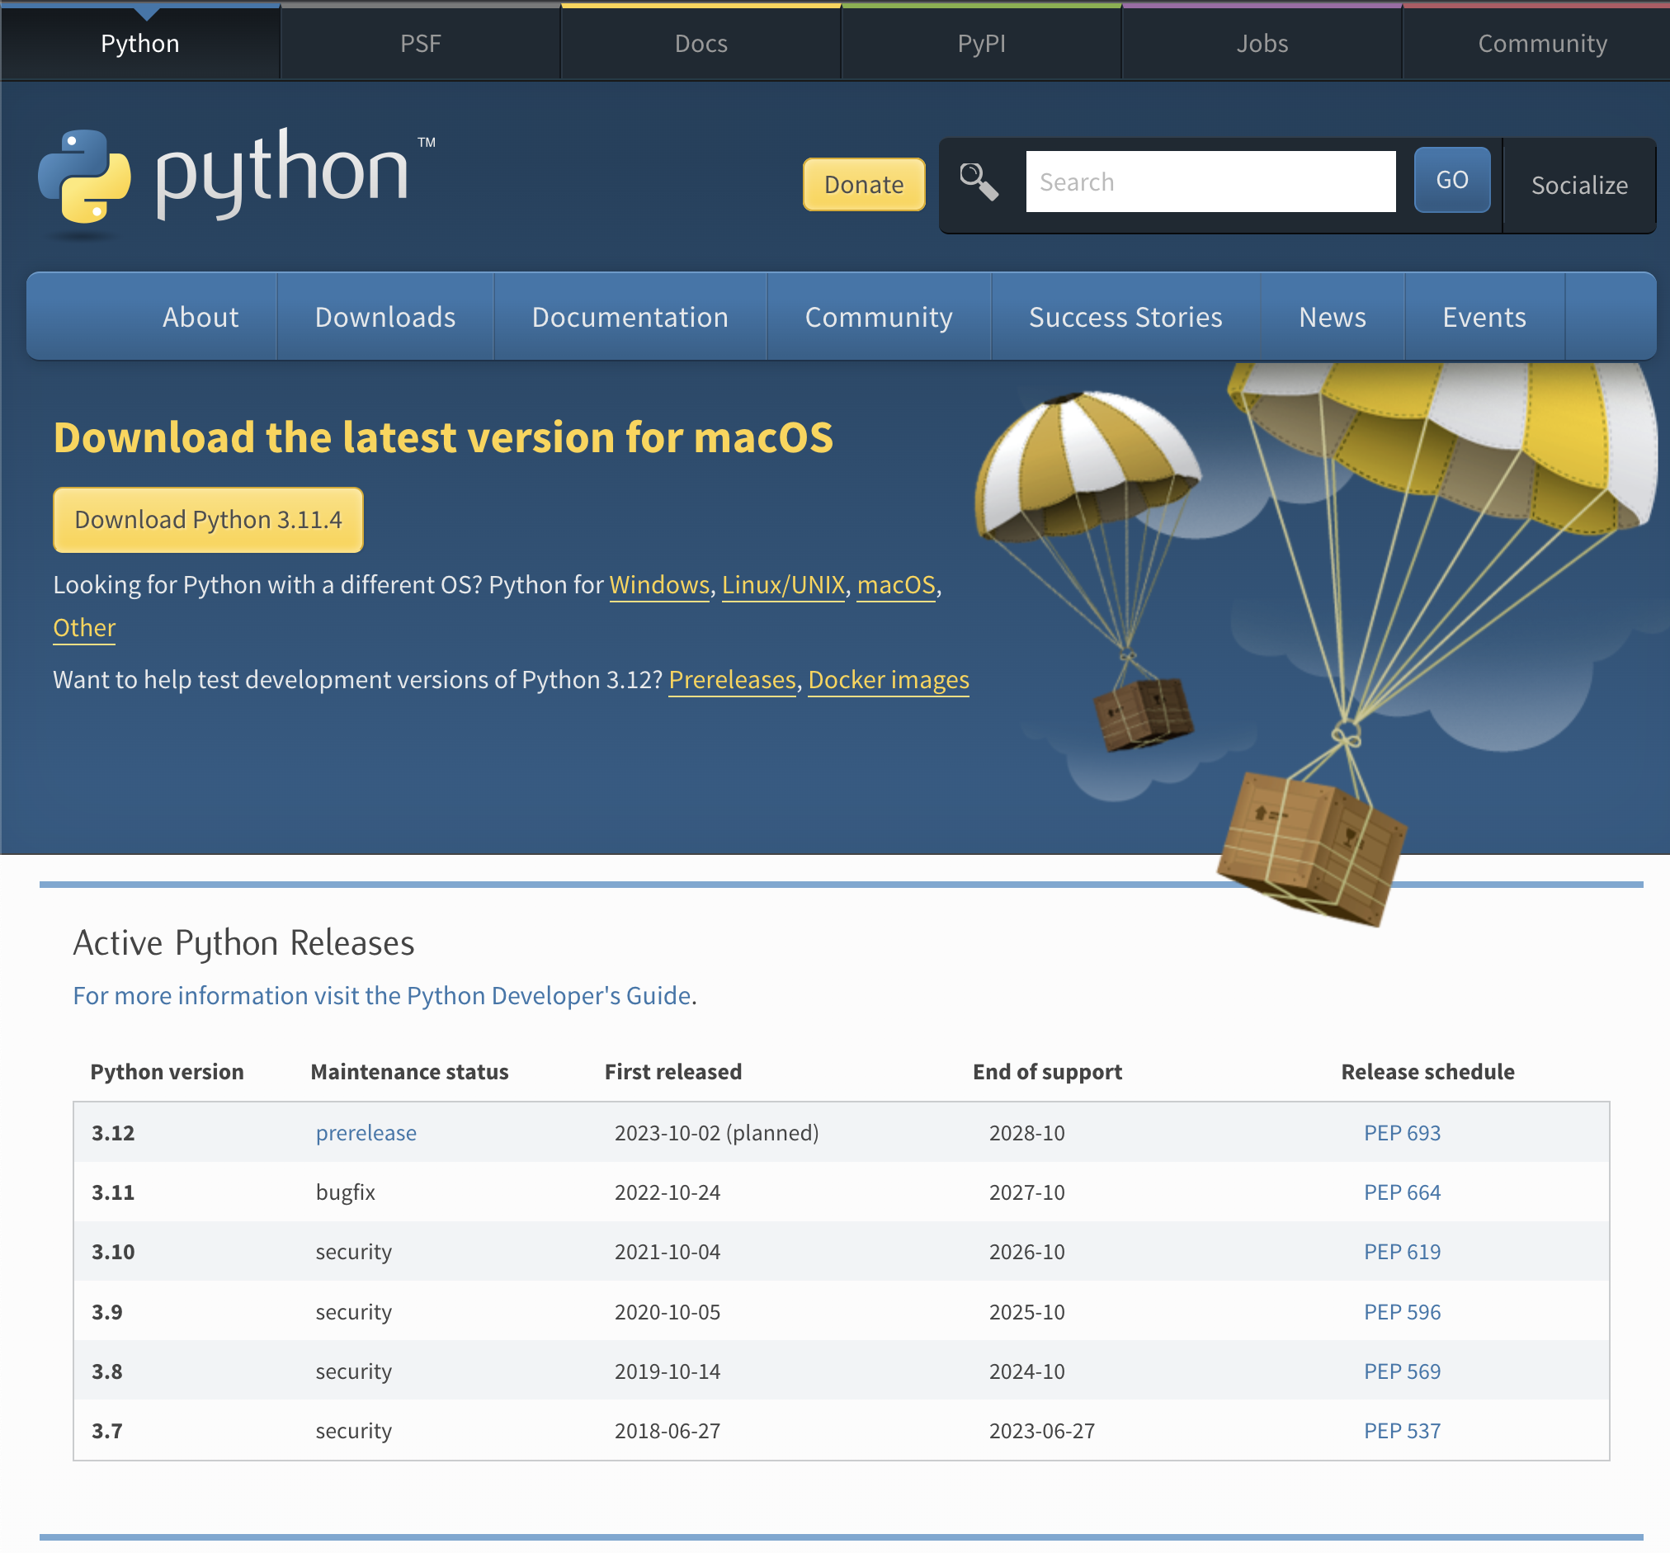
Tools of the Trade Python
Recommended minimum version 3.8+
Installer from python.org recommended
Recommended environment management:
Using Python’s built-in virtualenv: https://docs.python.org/3/library/venv.html
Install packages into virtual environment
Document project requirements using:
pip freeze > requirements.txt
https://www.python.org/downloads/

Slide 20


Tools of the Trade Python
Python is supported by Jupyter notebooks
Notebooks are a convenient way to combine code, text, and images in a single file
Notebooks are great for developing a narrative in your analysis
Notebooks are not a good choice for project setup, config, or model deployment
Use regular Python scripts (*.py) for that

Slide 21
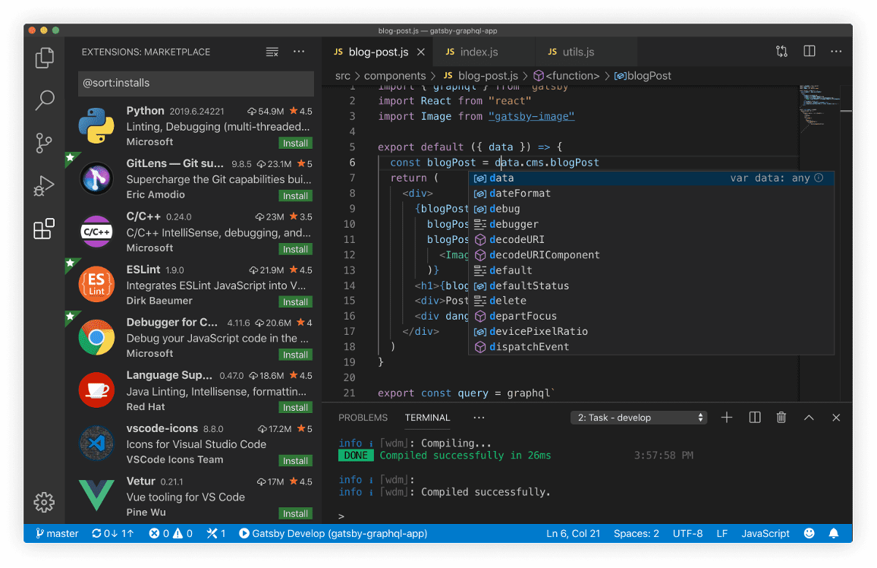
Tools of the Trade Visual Studio Code
Cross-platform (Windows, Mac, Linux)
Open source
Lightweight (no project files required)
Support for all sorts of languages
Syntax highlighting and autocomplete
Extensible in millions of ways
Natively supports Jupyter notebooks
Git built-in
Easy to get started
Many powerful advanced features
https://code.visualstudio.com/

Slide 22
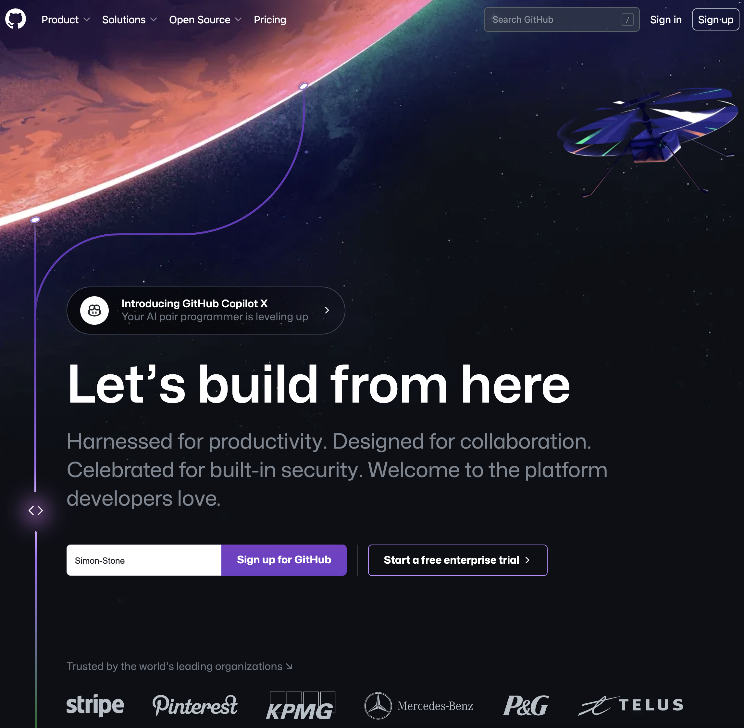
Tools of the Trade GitHub
Web-based platform for individuals and teams to collaboratively develop software projects
Uses the Git version control system
Also offers tools and services for
project management,
continuous integration and deployment,
documentation
Building up portfolio of projects on GitHub can benefit your job applications
https://www.github.com/

Slide 23
Tools of the Trade GitHub
Repository structure:
Many templates available on the internet:
http://drivendata.github.io/cookiecutter-data-science/
https://gist.github.com/ericmjl/27e50331f24db3e8f957d1fe7bbbe510
Try them out, learn what works, adjust and adapt to fit your flow
Consider creating a GitHub template repo

Slide 24
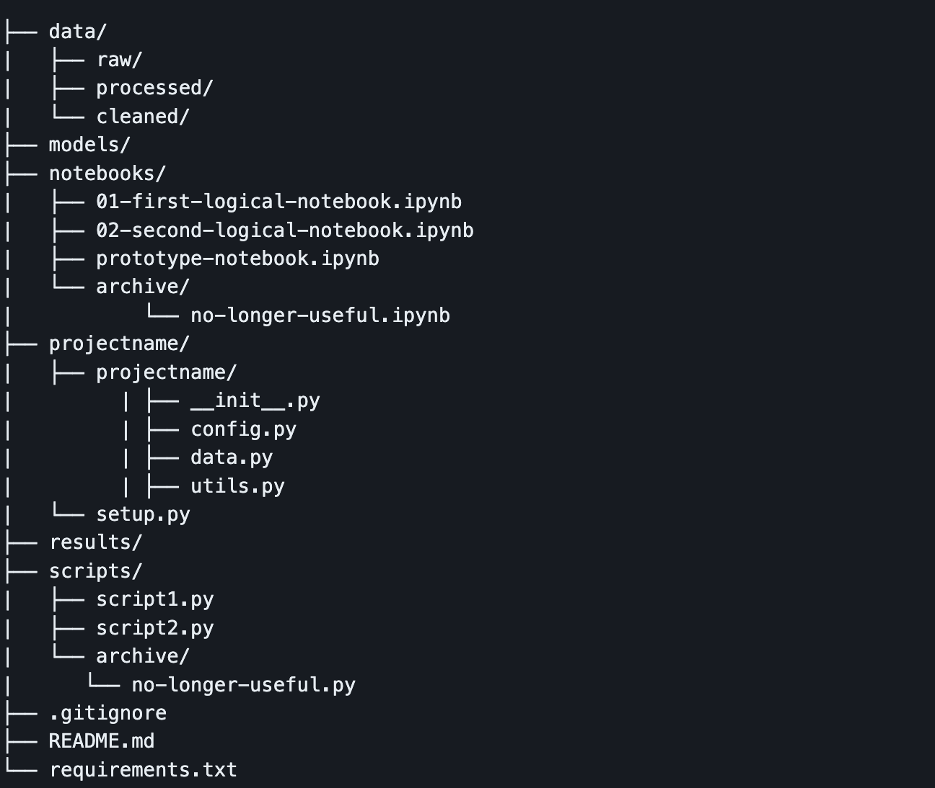
Tools of the Trade GitHub
An example structure you can use in this class:
Tour of the example repo
Not all of this will be helpful in every project
https://github.com/Simon-Stone/data-science-project-repo

Slide 25
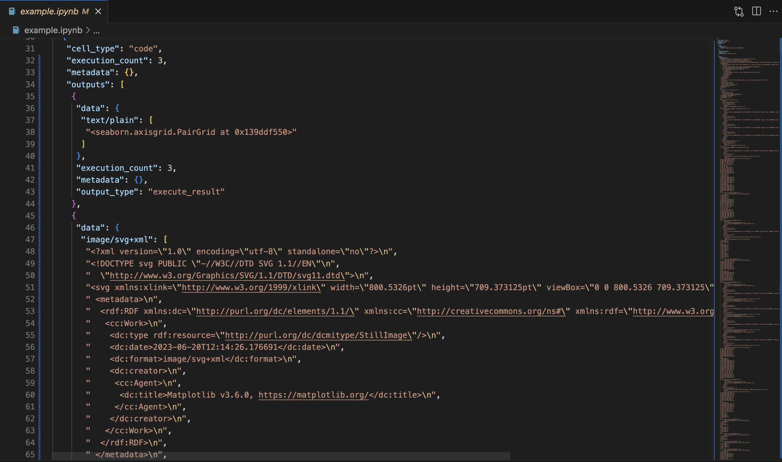
Tools of the Trade Bonus tip: Jupyter notebooks in Version Control
The problem:
Jupyter notebooks contain metadata, binary blobs, or other artifacts from execution
Git tracks changed lines in text files
Diffs become almost meaningless
Solution:
Always clear the output before committing
Use pre-commit hooks
Use nbstripout (https://github.com/kynan/nbstripout)

Slide 26
Assignment
Set up a skeleton project repository
Start thinking about a ”business/research question” you want to explore in your project
Start thinking about the kind of data you want to work with
Start looking for corresponding data
Is it already available as a dataset? API? Possible and allowed to scrape?

Slide 27
Thank you

